Slide 1

BLADE TEMPLATE
LARAVEL

Slide 2

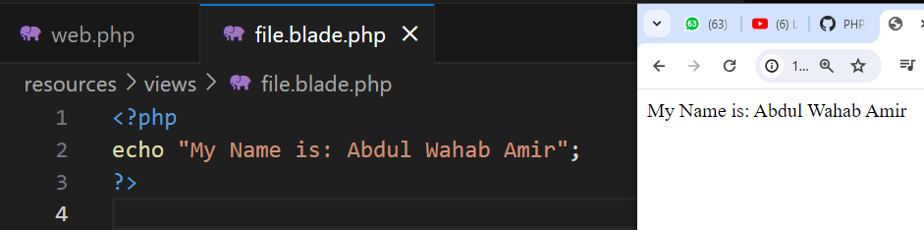
Your best quote that reflects your approach… “It’s one small step for man, one giant leap for mankind.”
PRINT ECHO IN PHP
- Neil Armstrong

Slide 3

{{ }}

Slide 4
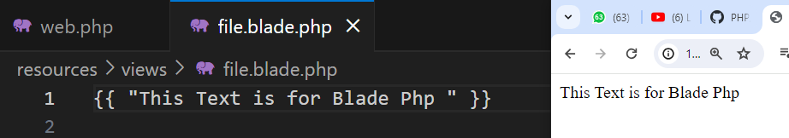
PRINT ECHO

Slide 5
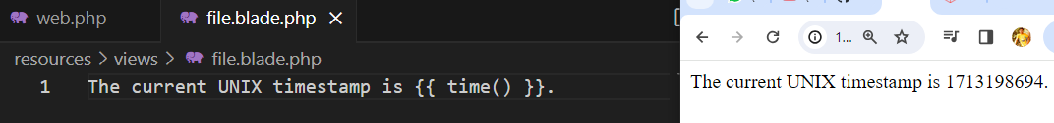
PRINT ECHO

Slide 6
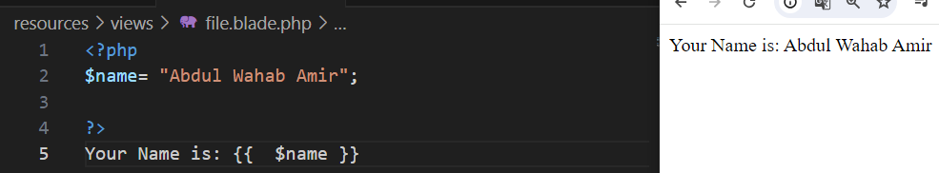
STORING VARAIBLES

Slide 7
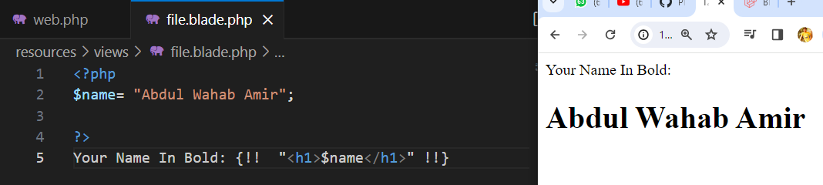
HTML TAGS

Slide 8
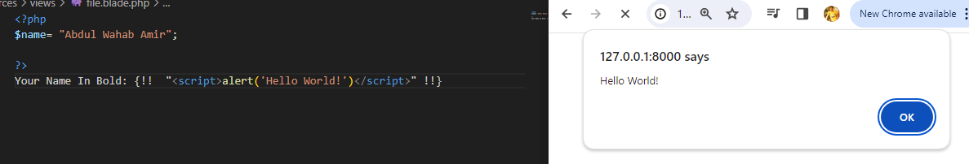
ALERT

Slide 9

INSTALLING THE EXTENSION

Slide 10
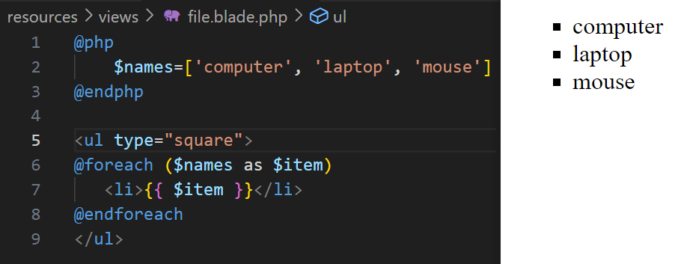
USING FOR EACH LOOP

Slide 11
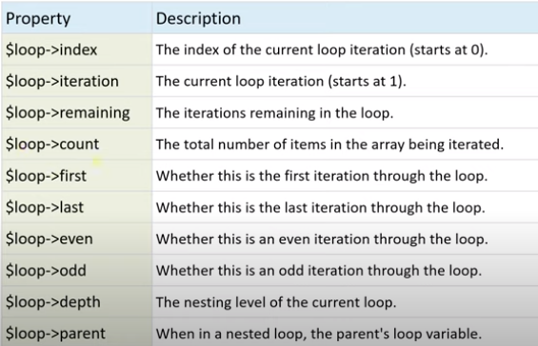
LOOP VARIABLES FOR EACH

Slide 12
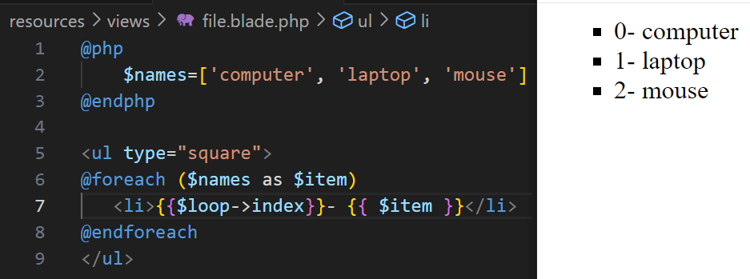
LOOP VARIABLES {{ index } }

Slide 13
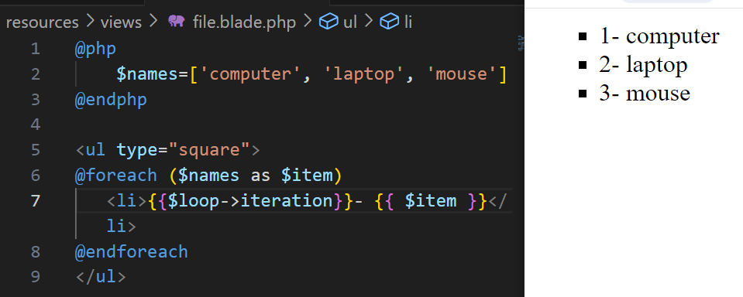
LOOP VARIABLES {{ iteration } }

Slide 14
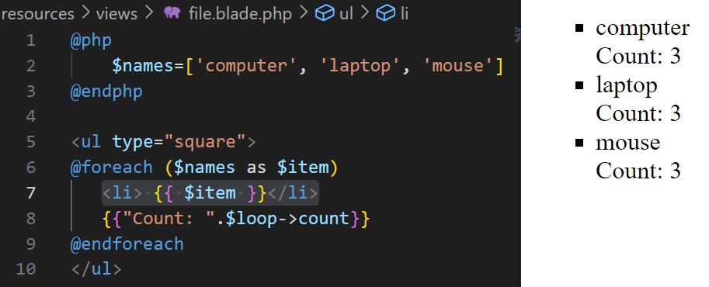
LOOP VARIABLES {{ count } }

Slide 15
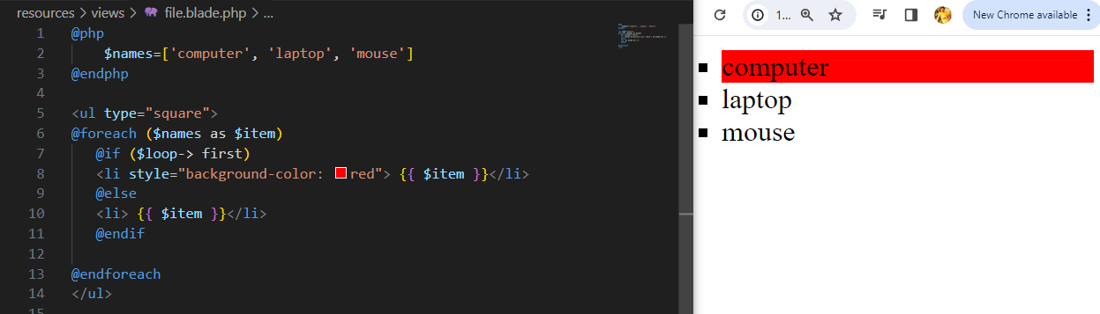
LOOP VARIABLES {{ first using if cond } }

Slide 16
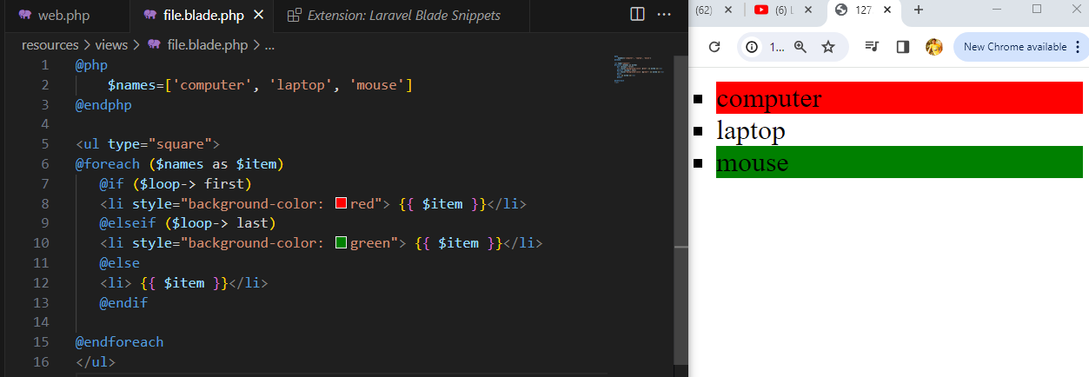
LOOP VARIABLES {{ first/last using if cond } }

Slide 17
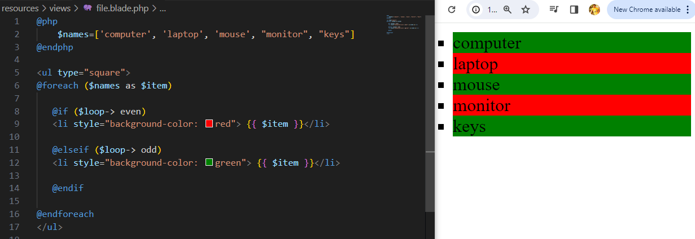
LOOP VARIABLES {{ even/odd using if cond } }

